Slide 1
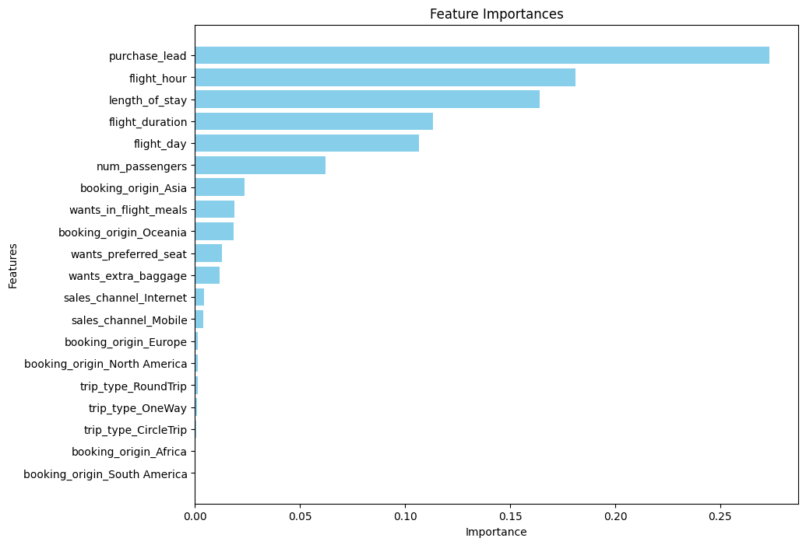
Results
Build a predictive model to understand factors that influence buying behaviour
Top Features:
Purchase Lead (that is the time between purchase and departure): Most influential.
Flight Hour: Highly impactful.
Length of Stay: Significant influence.
Flight Duration: Important.
Flight Day: Notable contribution.
Key Observations:
High Accuracy (85%): Overall, the model is performing quite well, getting most predictions right.
Imbalanced Performance: The model does an excellent job with Class 0 (‘booking_complete’ == False), but struggles with Class 1 (‘booking_complete’ == True), especially with a recall of 7%, primarily due to the imbalance in class distribution.

